Slide 1
HTML CSS, And JavaScript

Slide 2

Javascript
HTML
CSS

Slide 3
Where do HTML fits in?

Slide 4

Where do HTML fits in?
It defines the content for our application!
It defines visuals for our web software.

Slide 5
But what is HTML itself?
HTML stands for “HYPER TEXT MARKUP LANGUAGE”
Its word “Markup” comes from its usage of tagging i.e. < and >

Slide 6
But what is HTML itself?
Each tag appears as an object in the memory.
We can define our own tags as well.
Using HTML, we define the structure of our web site

Slide 7
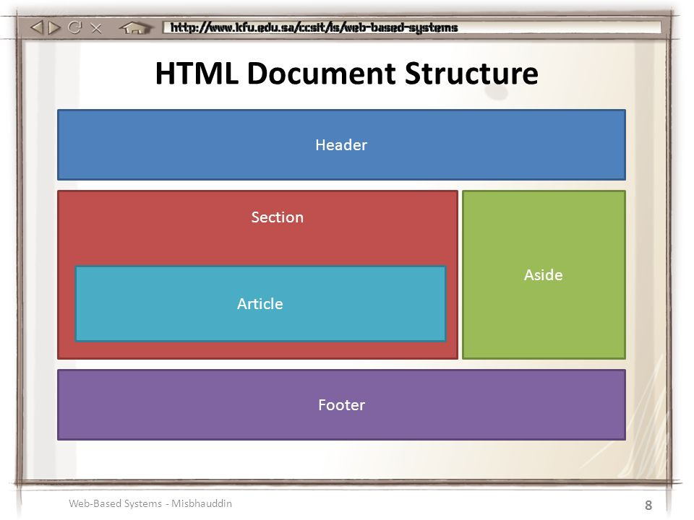
HTML lets us define document structure

Slide 8

Define document structure

Slide 9
Define document structure
navbar
section
aside

Slide 10
How HTML defines the content?
<h1>Pakistan</h1>

Slide 11
HTML tags
To insert an image in your webpage <image src=“images/myImage.png” />
To insert anchor tag in your web page <a href=“pages/myPage.html”>Link</a>

Slide 12
Attributes
Attributes can provide us additional information about HTML tag.
Using attributes, we can alter their state.
Different HTML tags have different attributes according to their type.

Slide 13
Attributes
<pc> </pc>

Slide 14
Attributes
<pc ram=“DDR3_8GB” hdrive=“SSD_128GB”></pc>

Slide 15
Attributes
<img id=“myImage” src=“images/saylani.png” />
Attribute Name = “id” Attribute Value = “myImage”
Attribute Name = “src” Attribute Value = “images/saylani.png”

Slide 16
Attributes
<a href=“pages/home.htm”>Home</a>

Slide 17

Attributes
<img href=“pages/home.htm” />
Image tag doesn’t know what to do with href attribute

Slide 18
A Basic HTML Page
<!doctype>
<html>
<head></head>
<body>
</body>
</html>
Document Type
Meta Information
Your Content

Slide 19
A Basic HTML Page
Head tag includes title, styles, external attachments, meta etc.
Body tag include all our visible content.

Slide 20

Okay, we got how to define HTML!

